Slide 1

September 27, 2017
Notes:
START PROMPTLY AT ~3:20
Bring FOOD!!!

Slide 2
Code Council 2017-18
Advisor
Mr. Ciavarella
Presidents
Sam Kaplan
Jeffrey Yu
Vice Presidents
Sam Miller
Sarah Pethani
Treasurer
Helayne Arden
Secretary
Harris Miller
Maxwell Sun
Community Outreach
Daniel Robbins
Notes:
[Jeffrey] Starts/intro
[Everyone] go around and say something about yourself. Say name, grade, and fun fact.

Slide 3
What is Code Club? Code Club is a club that teaches coding to students in a way that empowers them to build things and solve problems
Notes:
[Sam Kaplan] whole slide

Slide 4
We are one of many clubs around the globe. Hack Club is the worldwide movement of free student-led coding clubs. Brought to Roslyn in 2016 by Rachel Sterneck
Notes:
[Sam Miller]

Slide 5
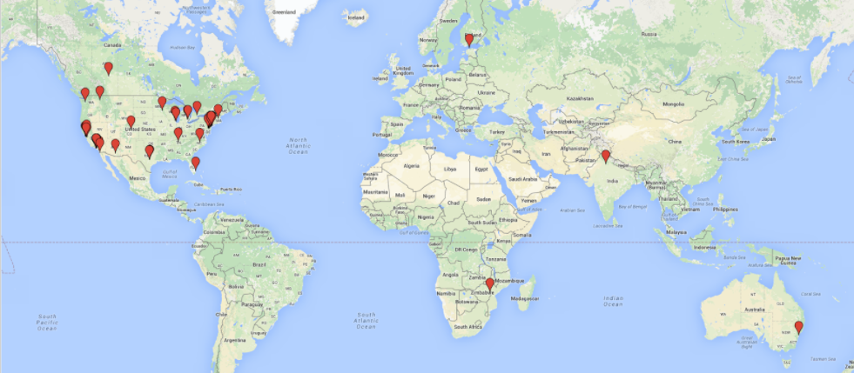
Hack Clubs around the World

Slide 6

Weekly Meetings
Meetings every Wednesday in Room 142 from 3:10 to ~4
Work on guided workshops, learning how to build things with code
In the beginning of the year, we will focus on HTML, CSS, and JavaScript
Focused on learning and you
Will transition to other topics based on interest of the club
Notes:
[Jeffrey Yu] whole slide

Slide 7
Competitions
Practice every Friday at 3:15
Consists of a written part (five questions) and a long answer coding part that is take home
Material
Everything from binary and hexadecimal conversions to LISP
There are Junior, Intermediate, and Senior sections, so don't worry if you don't have a lot of experience
Notes:
[Sam Kaplan] whole slide

Slide 8

Bryant Library Workshops
Workshops for students in elementary and middle school to learn coding
No prior experience needed
First Friday of each month from 3:30 to 5
Earn community service hours!
First workshop: November 3
Notes:
[Daniel R] whole slide

Slide 9
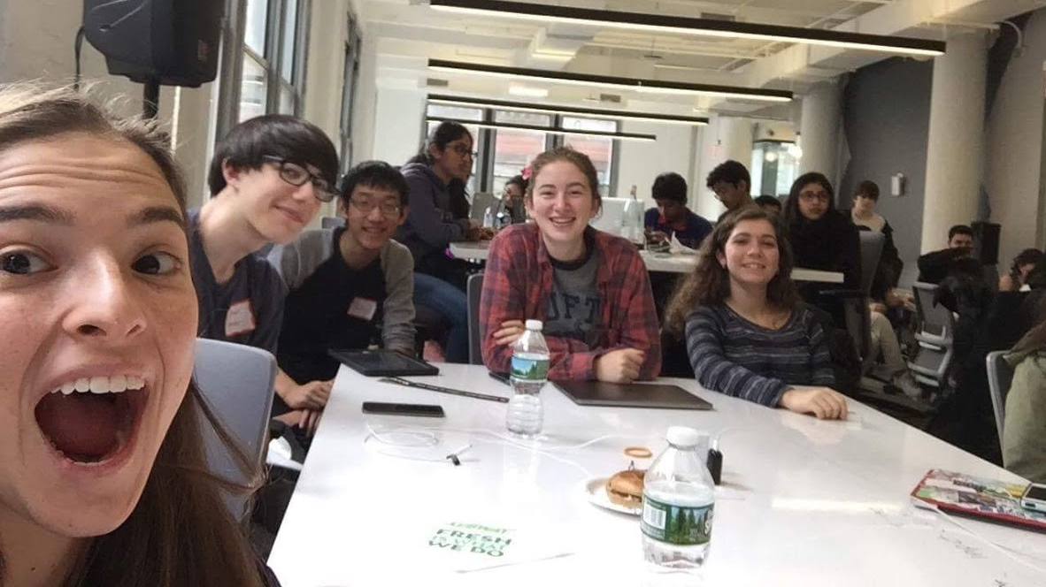
Hackathons!
24 hour coding events for students
Venue for self-expression and creativity
You and your team build an app, game, or anything you want
No experience needed!
Present to your peers
CodeDay NY November 11-12
We will host smaller, in-school club hackathons throughout the year
Notes:
[Jeffrey Yu] whole slide

Slide 10
Club Fair
Friday, October 6 (B Day)

Slide 11
DEMOS!!
Last year creations
Notes:
[Jeffrey Yu] introduction/transition

Slide 12

Totoro Jump
By Sarah Pethani
Created at Code Day Winter 2017 (February 18-19)
A simple infinite platform jumping game similar to the popular game Doodle Jump. Your player is Totoro and relaxing forest music plays in the background.
https://rhscode.github.io/totorojump/
Notes:
[Jeffrey Yu] transition
[Sarah Pethani] whole slide

Slide 13

Pineapple Smash
By Sam Miller & Sarah Pethani
Made for Code Club 2017 end of year hackathon
A fun, lighthearted game where one can take out their stress on a cute pineapple through rapid clicking. You can purchase multiple upgrades which increases the money you earn, whether it be through clicks, per second, or through a boost.
http://tinyurl.com/pineapple-smash
Notes:
[Jeffrey Yu] transition
[Sarah Pethani] whole slide

Slide 14
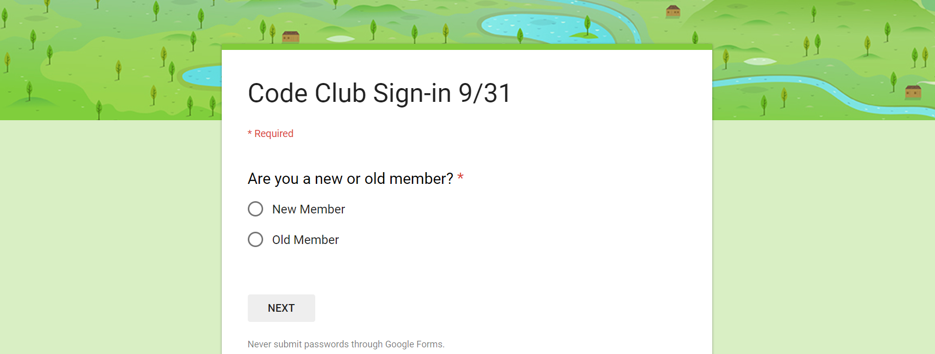
SIGN-IN: roslyncode.tech
Do this at every meeting!!!
Notes:
[Harris Miller] yell at people to do this
[Jeffrey Yu] I might explain some other things

Slide 15
See y’all next time! October 4, 2017 Bring a friend! Club Fair Preparation

